Slide 1
Privacy Aware Mobility Prediction Platform
Reading Exam Presentation
June 1 2016
Vaibhav Kulkarni
Advisor : Prof. Benoît Garbinato

Slide 2
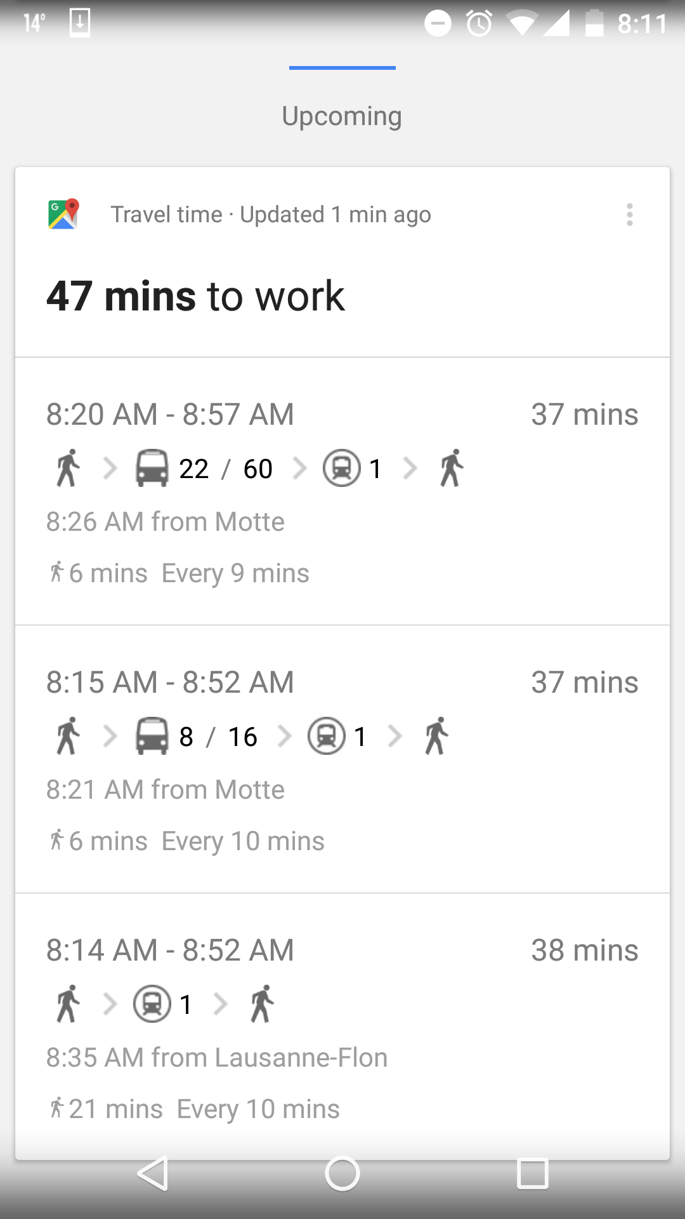




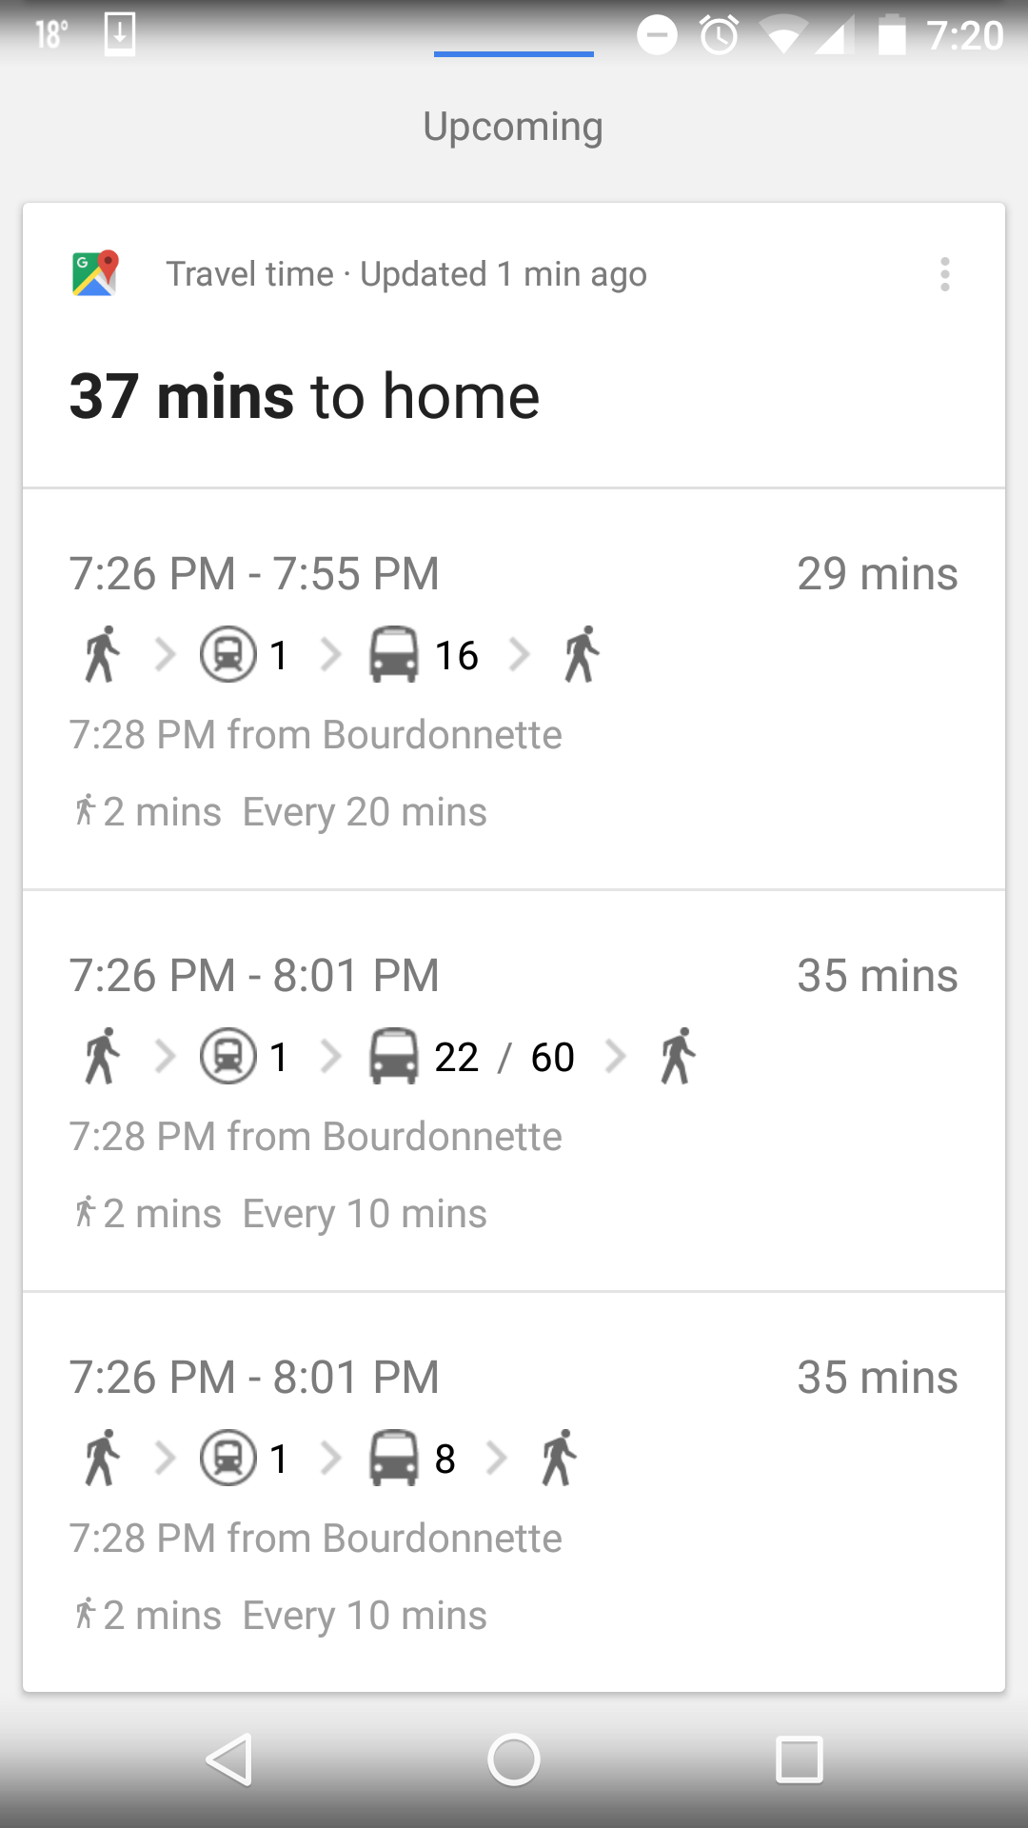


Bob on Friday

Slide 3
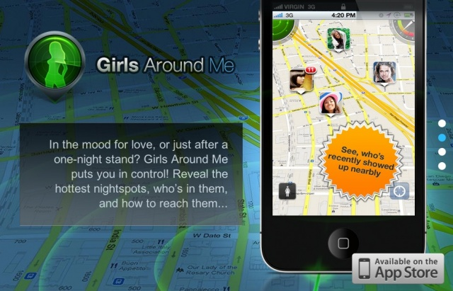

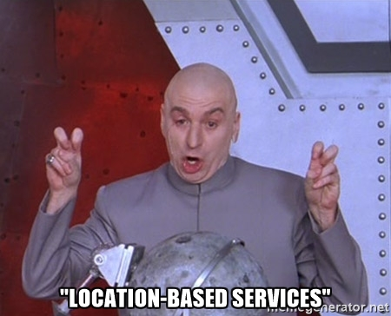



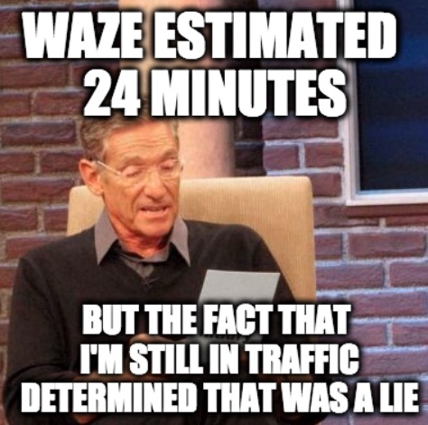
The Other Side

Slide 4
Where is the problem ?
Need to design reliable and robust protocols
How to test and evaluate them under interference ?
Interferer location is often unknown
How to localize the interferers in a wireless network ?

Slide 5
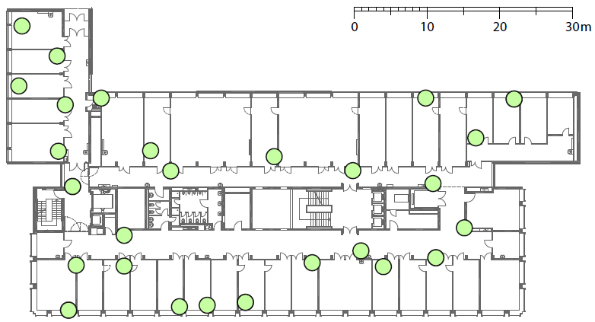


Contributions
A platform to generate controllable and repeatable interference
FlockLab
CIG
A platform to localize interferers built on top on existing sensor network infrastructure

Slide 6
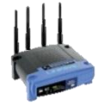
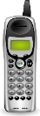
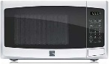
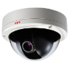
Current Approaches
FlockLab
Lack of controllability
Cannot be operated remotely
Lack of realism
Cumbersome

Slide 7
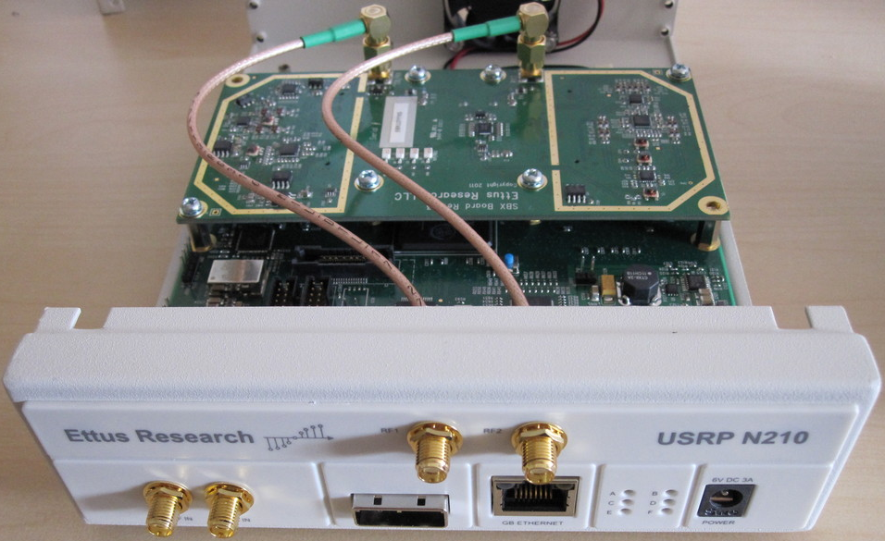
Software Defined Radio
Implement communication system components in software
GNU Radio to construct wireless system flow graph
USRP N210 – SBX 40 MHz

Slide 8
CIG Design
USRP N210
v
Record & Playback
Software
Radio
Imp.

Slide 9
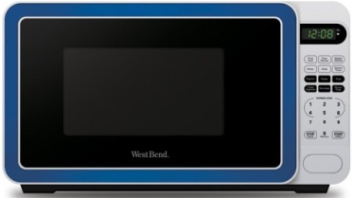

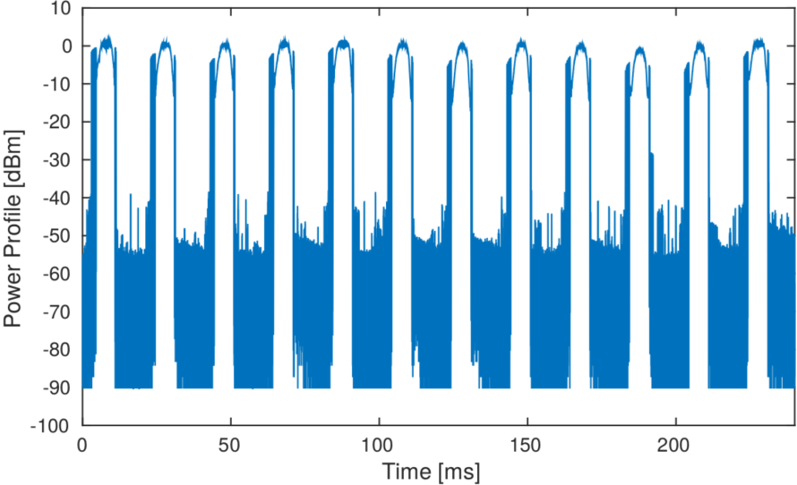
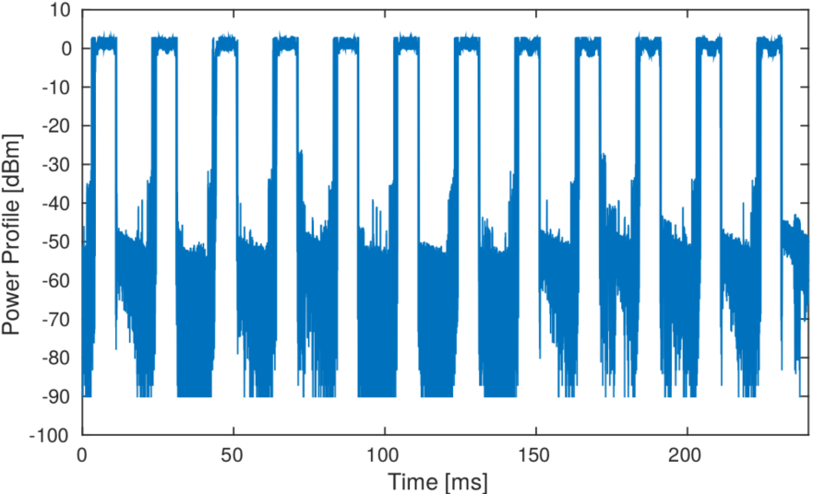
Record & Playback
Record & Playback
CIG
Clatronic Microwave Oven
CIG Microwave Oven
Correlation Coefficient : 0.926

Slide 10
CIG Design
USRP N210
v
Record & Playback
Software
Radio
Imp.

Slide 11
Software Radio Implementation
Application Layer
GNU Radio
MAC
CRC Generator
Vector
Source
DSSS/
FHSS
RF Front
End
Packet
Encoder
Modulator
Pulse Shaping Filter
Rational
Resampler
DSP Freq.
Tuning
LO Freq.
Tuning
Digital PHY
Analog PHY

Slide 12




CIG Design
USRP N210
v
Raspberry Pi
Off-the-shelf
Chipsets
Record & Playback
Software
Radio
Imp.
Host SW
Internet

Slide 13
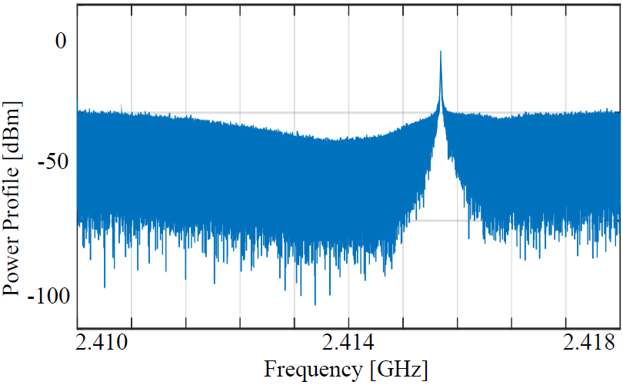
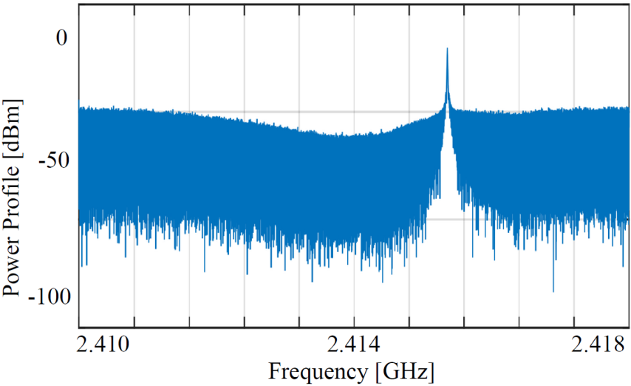
Analog Phone
Vtech Analog Cordless Phone
CIG Analog Cordless Phone
Correlation Coefficient : 0.998

Slide 14
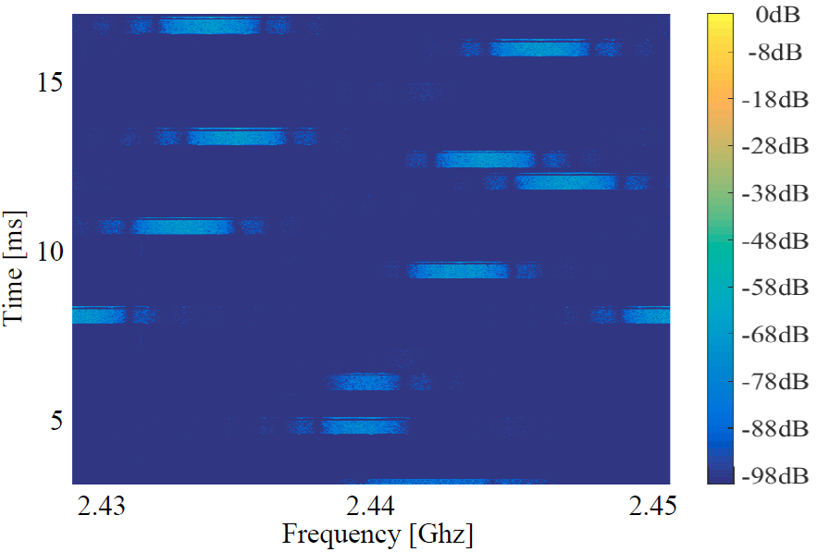
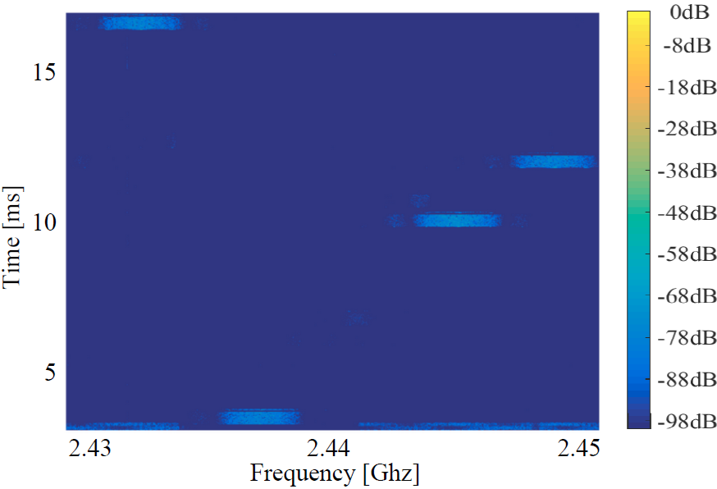
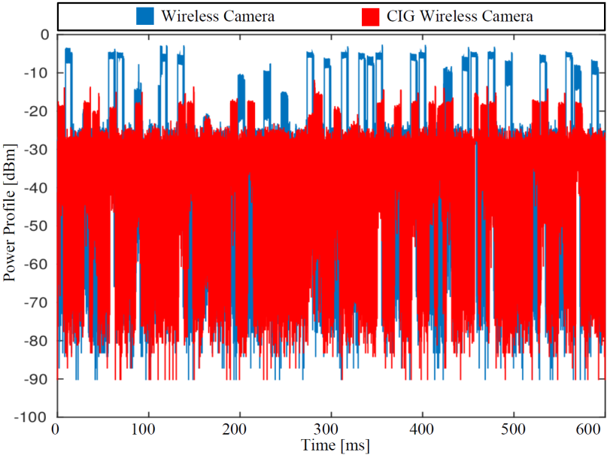
Wireless Camera
Philips Wireless Camera
CIG Wireless Camera
Correlation Coefficient per Packet : 0.930

Slide 15
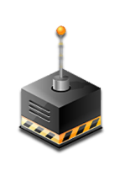
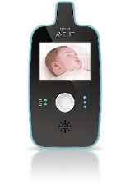
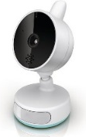
Impact on Communication Link
802.15.4 Transmitter
Interferer
Receiver
CIG
CIG
Receiver
Packet length 20
Bytes and 60 Bytes
4m
802.15.4 Receiver
Interferer
Transmitter
CIG
CIG
Transmitter
Distance 3m and 6m
Packet reception rate
Packet corruption and loss rate
Packet burst error and symbol burst error length

Slide 16
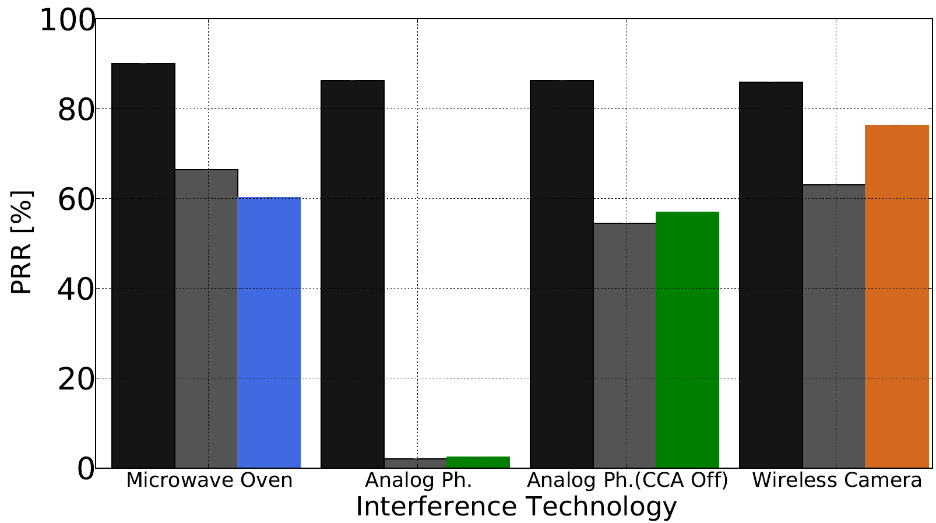
Link Impact Comparison
No Interference
Actual Interferer
Packet Reception Rate Comparison
High accuracy for analog phone
Reasonable accuracy for microwave oven
Low accuracy for wireless camera

Slide 17
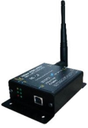


Interferer Localization
Estimate location of uncooperative interfering radios
Unknown parameters such as wireless signal strength
Current approaches: PinPoint and WiFiNet
Device
Signatures
Received
Signal Strength
Angle of Arrival
Device
Signatures
Received
Signal Strength
Device
Signatures
Angle of Arrival
Received
Signal Strength
Angle of Arrival

Slide 18
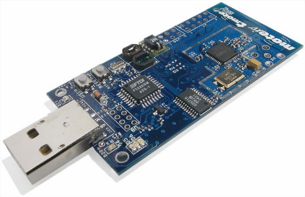
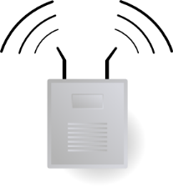



Challenges
Single omnidirectional antenna
Limited spectral view and scanning rate
Constrained computational capability
TMote Sky Node
Distance

Slide 19
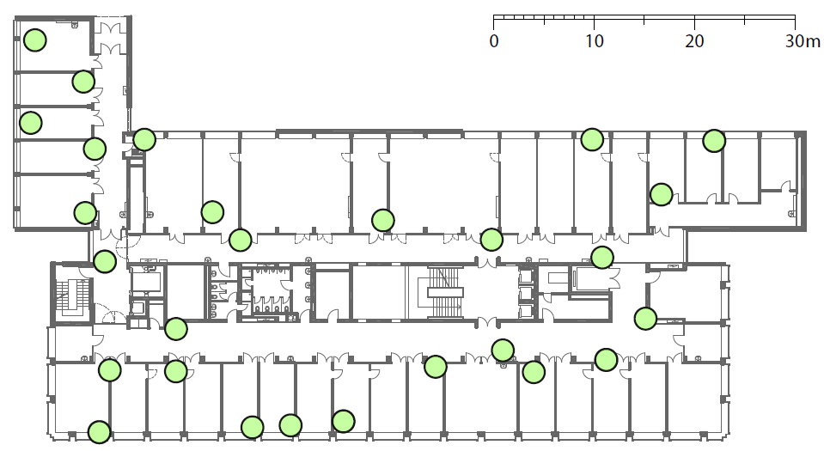
Implementation
FlockLab
-45
-54
-62
-67
-32
-83
Model propagation loss characteristics
Identify ideal anchor nodes
Detect interference and compute RSS
Collaborate with neighbors to estimate location

Slide 20
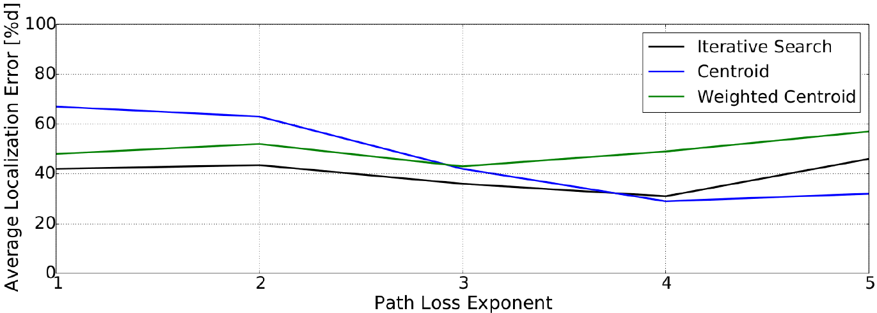
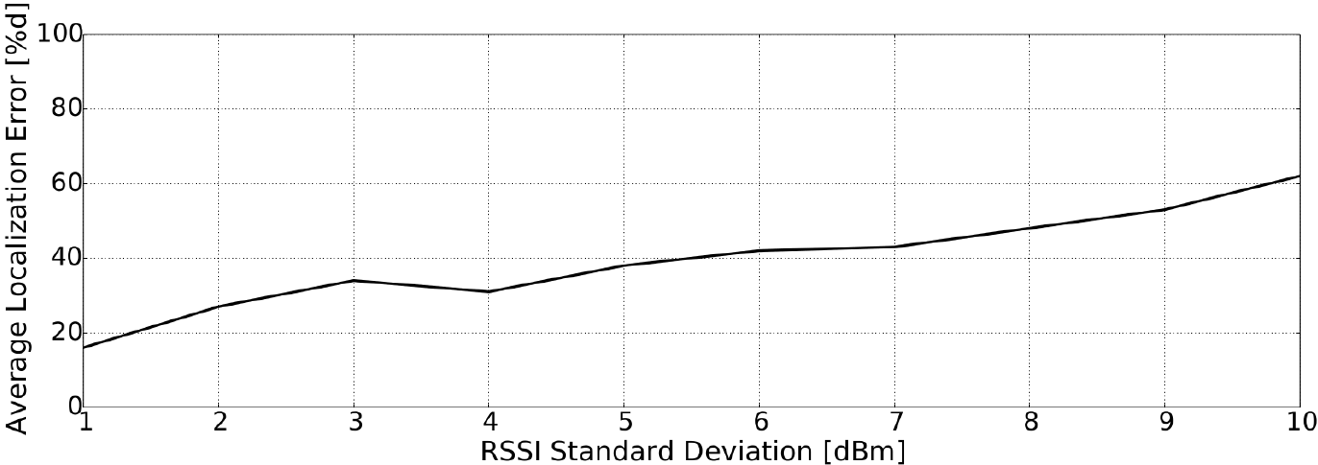
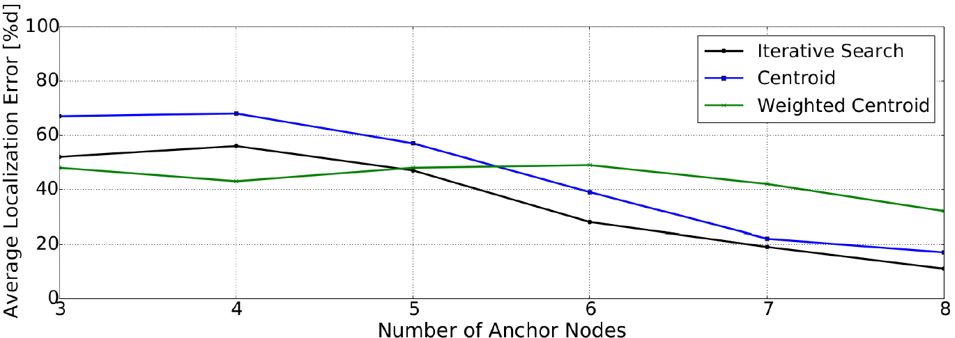
Evaluation
Low RSSI standard deviation : High accuracy
High number of ideal anchors: High accuracy
High path loss exponent: High accuracy

Slide 21
Conclusion
Interference mitigation is a challenge
Lack of infrastructure to generate controllable interference
We put forth CIG to generate controllable interference
A platform to localize uncooperative RF radios
Leverages sensor network infrastructure as backbone
Achieves point level accuracy of 2m

Slide 22

Thank You!

